Slide 1
EVADC Timing 19 May 2021
C_PMC_11F/5.1/27-Feb-19

Slide 2
List of ADC Channels
51 Adc Channel
AFC | DABP | DABS | Control Board
VAC1_SNS_PM1IN | VAC1_SNS_PM2IN | VAC1_SNS_PM3IN | AMB_SENSE_1
VAC2_SNS_PM1IN | VAC2_SNS_PM2IN | VAC2_SNS_PM3IN | AMB_SENSE_2
VAC3_SNS_PM1IN | VAC3_SNS_PM2IN | VAC3_SNS_PM3IN
VDC_SNS_PM1IN | VDC_SNS_PM2IN | ILEG1_SNS_PM3IN
IPH1_SNS_PM1IN | ILEG1_SNS_PM2IN | ILEG2_SNS_PM3IN
IPH2_SNS_PM1IN | ILEG2_SNS_PM2IN | ILEG3_SNS_PM3IN
IPH3_SNS_PM1IN | ILEG3_SNS_PM2IN | IPH1_SNS_PM3IN
ILEG1_SNS_PM1IN | IPH1_SNS_PM2IN | IPH2_SNS_PM3IN
ILEG2_SNS_PM1IN | IPH2_SNS_PM2IN | IPH3_SNS_PM3IN
ILEG3_SNS_PM1IN | IPH3_SNS_PM2IN | TEMP_HS_SNS_PM3IN
TEMP_HS_SNS_PM1IN | TEMP_HS_SNS_PM2IN | TEMP_PCB_SNS_PM3IN
TEMP_PCB_SNS_PM1IN | TEMP_PCB_SNS_PM2IN | TEMP_LEG1_SNS_PM3IN
TEMP_LEG1_SNS_PM1IN | TEMP_LEG1_SNS_PM2IN | TEMP_LEG2_SNS_PM3IN
TEMP_LEG2_SNS_PM1IN | TEMP_LEG2_SNS_PM2IN | TEMP_LEG3_SNS_PM3IN
TEMP_LEG3_SNS_PM1IN | TEMP_LEG3_SNS_PM2IN | 24V_SNS_PM3IN
24V_SNS_PM1IN | 24V_SNS_PM2IN | VDC_SNS_PM3IN
 |  | CUR_SNS

Slide 3
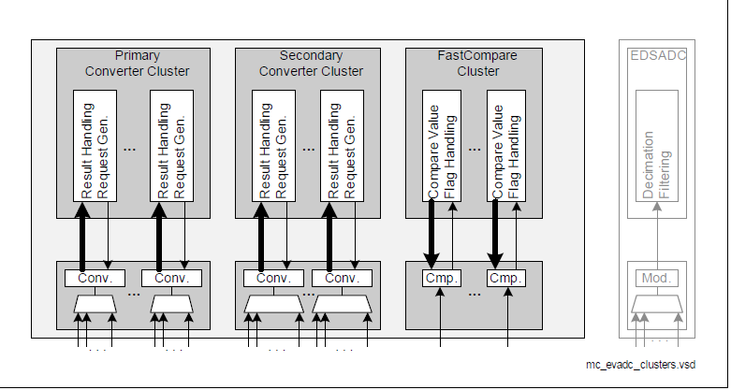
Datasheet Reference of converters in TC377TP
Primary converter - 8 Stage queues - conversion time below 0.5us
Secondary Converter – 16 stage queus – conversion time below 1us

Slide 4
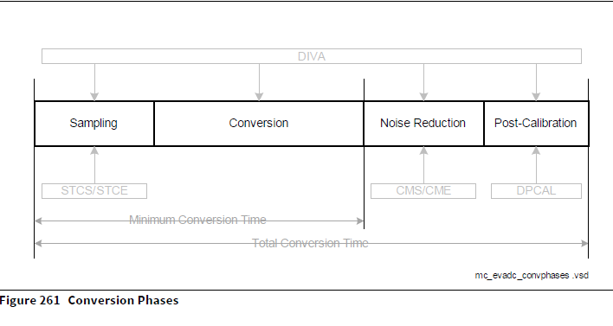
ADC Maximum frequency 20Mhz
Sample time minimum 100ns
Result generation time 650ns
Minimum time of conversion without post calibration is 768.75ns (single channel)

Slide 5
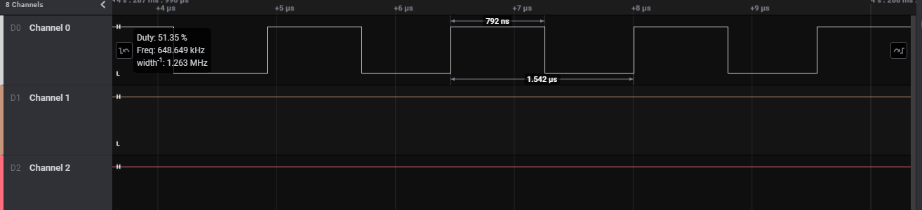
Sample time 100ns – primary channel
Captured Waveform Primary single channel
Each conversion to result generation takes 792ns for single channel
For 8 channel the Timing will be 6.4us

Slide 6
Each group has 3 queue with respective stages(8/16)
Using that queue we can configure the priority of the channel.
ADC has 4 priority (highest,high,low,lowest)
Primary converter dedicated to closed loop channels – (8 channels)
Closed Loop Channel | PRIMARY CONVERTER
VAC1_SNS_PM1IN
VAC2_SNS_PM1IN
VAC3_SNS_PM1IN
VDC_SNS_PM1IN
IPH1_SNS_PM1IN
IPH2_SNS_PM1IN
IPH3_SNS_PM1IN
VDC_SNS_PM3IN
CUR_SNS
Low Priority | High Priority
VAC1_SNS_PM1IN | IPH1_SNS_PM1IN
VAC2_SNS_PM1IN | IPH2_SNS_PM1IN
VAC3_SNS_PM1IN | IPH3_SNS_PM1IN
VDC_SNS_PM3IN
CUR_SNS

Slide 7
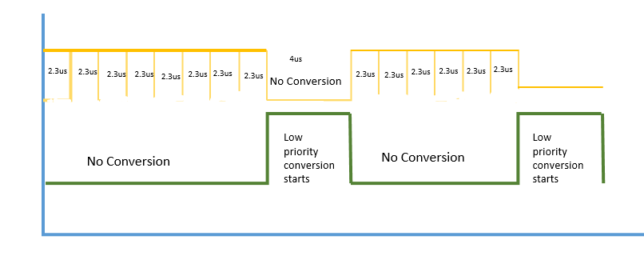
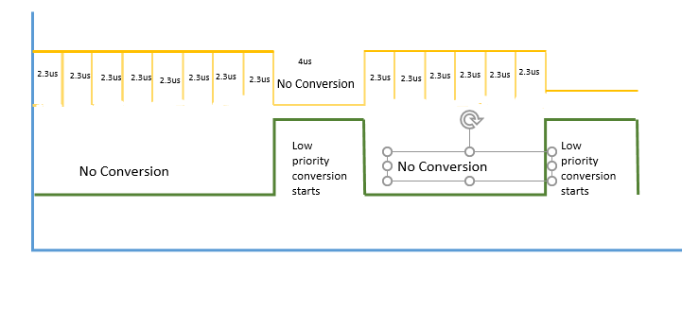
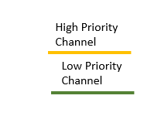
Conversion sequence of Priority queue Closed Loop
Note : all priority queues finally go to the same converter to get the adc result

Slide 8
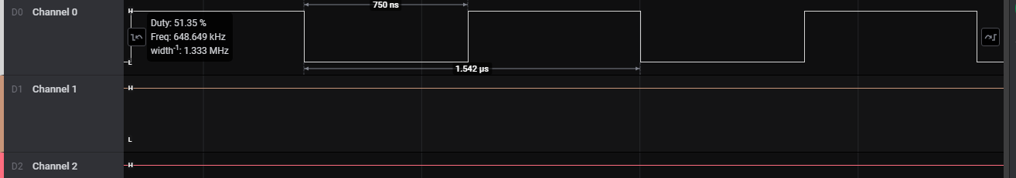
Sample time 100ns – secondary Channel
Each conversion to result generation takes 750ns for single channel
In datasheet, the minimum time for secondary converter is 1.2us
For 41 channel the timing will be 31 us

Slide 9
Secondary converter has 41 channel ( including Volt-Sec Balance)
All channel will go to single converter (Secondary Converter)
Low Priority
TEMP_HS_SNS_PM1IN
TEMP_PCB_SNS_PM1IN
TEMP_LEG1_SNS_PM1IN
TEMP_LEG2_SNS_PM1IN
TEMP_LEG3_SNS_PM1IN
TEMP_HS_SNS_PM2IN
TEMP_PCB_SNS_PM2IN
TEMP_LEG1_SNS_PM2IN
TEMP_LEG2_SNS_PM2IN
TEMP_LEG3_SNS_PM2IN
TEMP_HS_SNS_PM3IN
TEMP_PCB_SNS_PM3IN
TEMP_LEG1_SNS_PM3IN
TEMP_LEG2_SNS_PM3IN
TEMP_LEG3_SNS_PM3IN
AMB_SENSE_1
AMB_SENSE_2
Temperature rising will happen slowly
The Low priority Channel will get converted once in every 1sec
We can reduce 15 channels in this approach (11.9us)
Remaining channel will conversion will happen in every 19.1us

Slide 10
If we consider volt sec balance channel for continuous scanning mode then we can get result in 2.3us ( 3 channel together)
High Priority
VAC1_SNS_PM2IN | Volt Sec Balance
VAC2_SNS_PM2IN
VAC3_SNS_PM2IN
The below mentioned pins are getting affected which has medium priority
ILEG1_SNS_PM1IN | Affecting Pins
ILEG2_SNS_PM1IN
ILEG3_SNS_PM1IN
ILEG1_SNS_PM2IN
ILEG2_SNS_PM2IN
ILEG3_SNS_PM2IN
ILEG1_SNS_PM3IN
ILEG2_SNS_PM3IN
ILEG3_SNS_PM3IN
IPH1_SNS_PM2IN
IPH2_SNS_PM2IN
IPH3_SNS_PM2IN
IPH1_SNS_PM3IN
IPH2_SNS_PM3IN
IPH3_SNS_PM3IN

Slide 11
Conversion sequence of Priority queue Secondary Converter
10 cycle 23 us
High priority Channel
2.3 uS
2.3 uS
Medium priority Channel
9 uS
9 uS
9 uS
No Conversion
No Conversion
No Conversion
Low priority Channel
500 ms

Slide 12
Limitation:
Multiple queue concept but all the queue using the same two converter (Primary and Secondary)
The minimum conversion time for single channel is 750ns.

Slide 13
THANK YOU
C_PMC_11F/5.1/27-Feb-19

